Slide 1


SAP S/4HANA Training
MASTER DATA GOVERNANCE (SAP MDG)
Neeraj Gupta
Session 04
SAP MDG –Data Modelling (Standard)

Slide 2
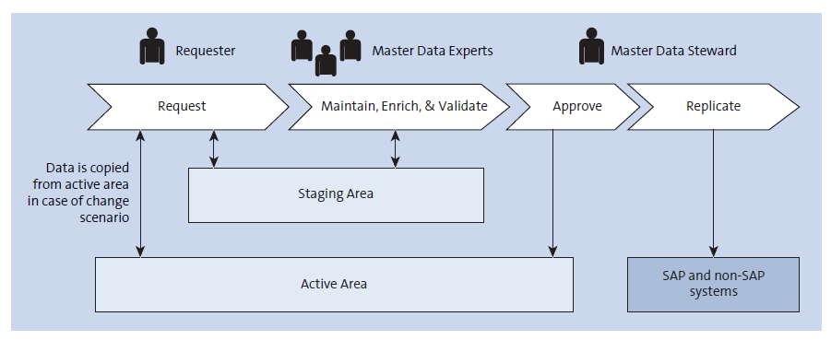
Staging and active area concept for master data create
4
SAP MDG – Data Modelling

Slide 3
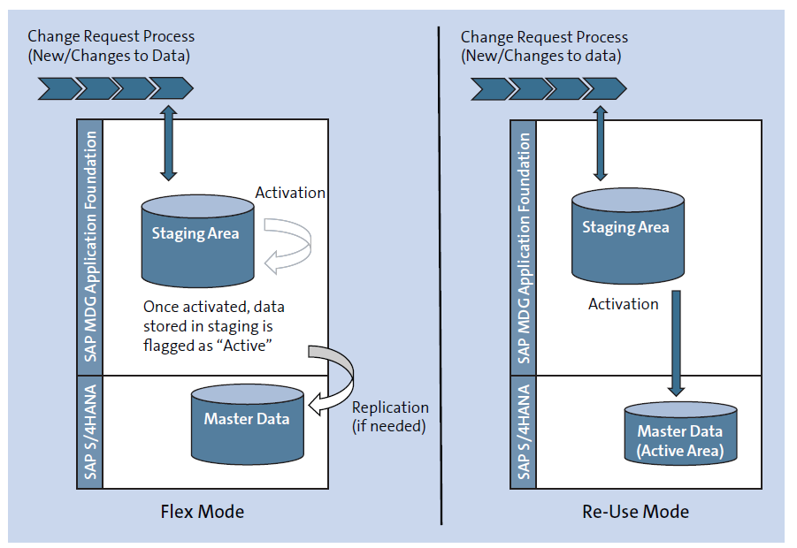
Flex and reuse modes
4
SAP MDG – Data Modelling

Slide 4
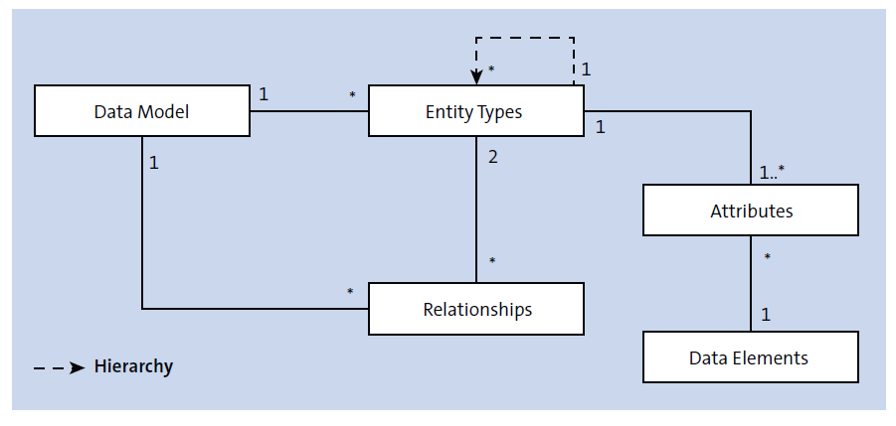
ERM Diagram of a data model
4
SAP MDG – Data Modelling

Slide 5
Entity Types for Hierarchies
4
SAP MDG – Data Modelling
Hierarchy Name
No Special Use - Entity types can be used as actual nodes and as lower-level hierarchy nodes in a hierarchy
Range Permitted on End Nodes - Entity types used as lower nodes can have range of values
Options

Slide 6
Hierarchy attribute - Hierarchy attributes can be defined for each relationship between nodes in a hierarchy using data elements or using a reference to an entity type
4
SAP MDG – Data Modelling

Slide 7
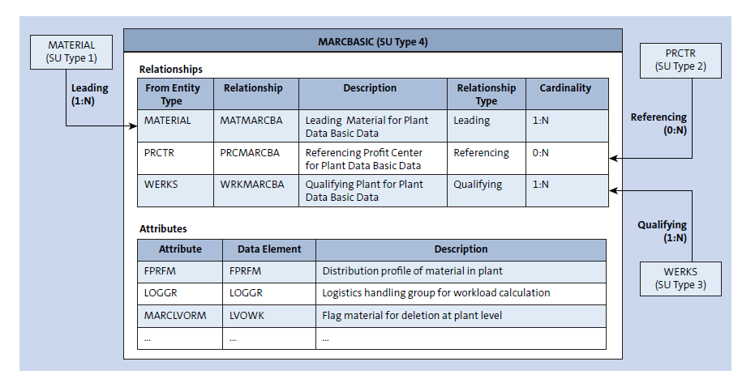
Material Master Data Model example
4
SAP MDG – Data Modelling

Slide 8
4
SAP MDG – Data Modelling

Slide 9

End of Session 04

Slide 10

Questions

Slide 11

Neeraj gupta

Slide 12


We’re committed to empower you to be
Most Desirable Resource
through powerful training solutions.
We build the workforce of the future.
250+
Corporate Clients
30,000+
Learners Trained
25000+
Learners Placed
FREE WEBINARS
Sign up for free webinars with industry experts every fortnight!
Enroll Now!
Contact us today!
https://anubhavtrainings.com/

Slide 13




More from AnubhavTrainings.com

